Slide 1

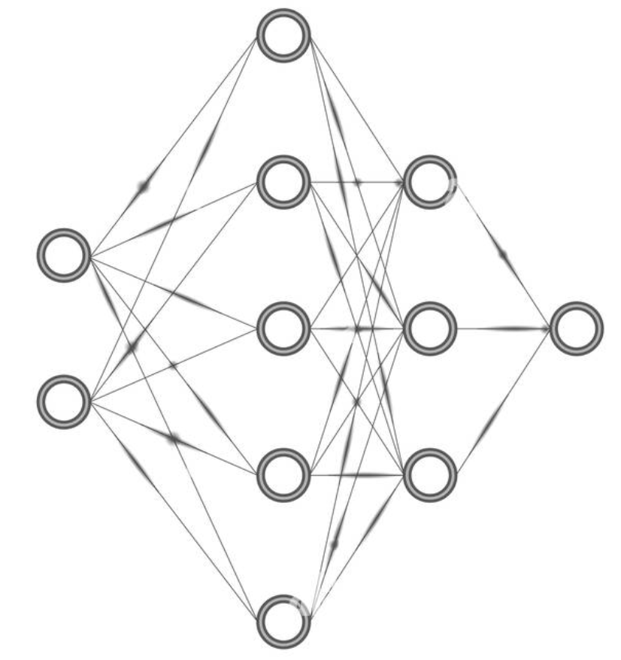
SRH Hochschule Heidelberg
Case Study 1
PRESENTATION
Anomaly Detection in Thermal Images
26 September 2022
Game Changers Team

Slide 2
CONTENTS
01
02
03
04
INTRODUCTION
LITERATURE REVIEW
DATA PREPARATION
RESEARCH& RESULTS
05
06
07
08
CONCLUSION
CODE &REPORT
PROJECT PLANNING
WHAT IS NEXT?

Slide 3
01
INTRODUCTION

Slide 4
01_INTRODUCTION
What is the problem?
What is the Solution?
Anomaly detection is a classical problem in machine learning, where datasets are highly biased towards normal classes due to the insufficient size of the abnormal class. Meanwhile detecting unseen anomaly cases makes utilizing supervised methods impossible.
These challenges lead the researchers to lean towards methods that use inference of latent space. At the heart of these methods, stands Autoencoders and Generative adversarial networks that map the input image to a lower dimension vector, which is then used to reconstruct the generated output image.

Slide 5
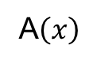
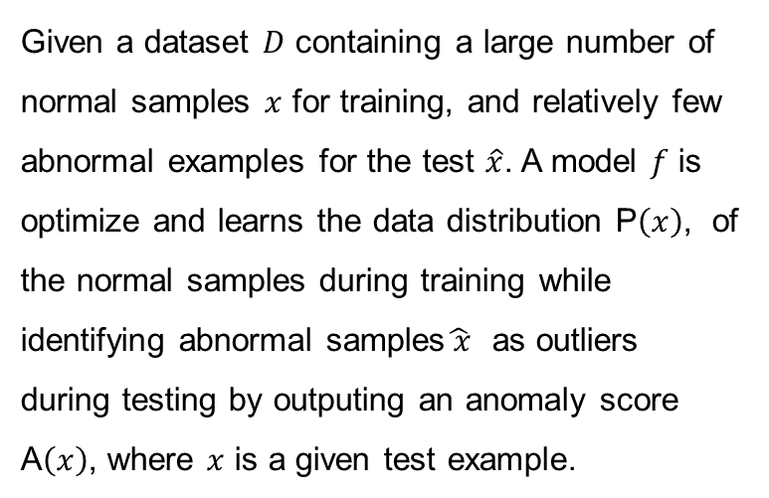
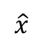
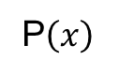
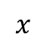
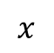
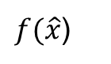
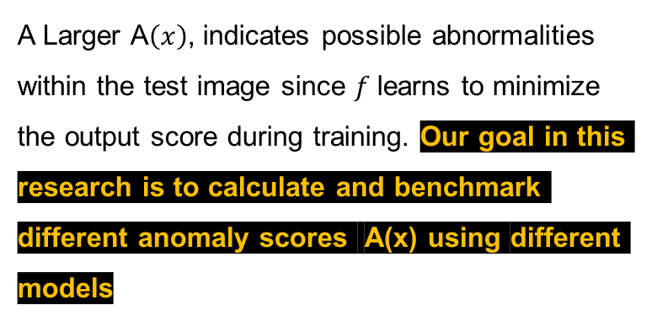
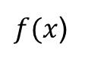
01_INTRODUCTION
Anomaly detection is a classical problem in machine learning
Given a dataset $D$ containing a large number of normal samples $x$ for training, and relatively few abnormal examples for the test $\hat{x}$. A model $f$ is optimize and learns the data distribution P$\left(x\right)$, of the normal samples during training while identifying abnormal samples$\hat{ x}$ as outliers during testing by outputing an anomaly score A$\left(x\right)$, where $x$ is a given test example.
A Larger A$\left(x\right)$, indicates possible abnormalities within the test image since $f$learns to minimize the output score during training. Our goal in this research is to calculate and benchmark different anomaly scores A(x) using different models
Train
P$\left(x\right)$
$$x$$
$f(x$)
Test
A$\left(x\right)$
$$x$$
$$\hat{x}$$
$f(\hat{x}$)

Slide 6
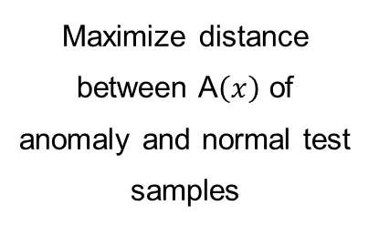
01_INTRODUCTION
The goals of Anomaly score A(x)
01
02
03
04
Maximize distance between A$\left(x\right)$ of anomaly and normal test samples
Leads to find best threshold for separating score space
Same function for unseen anomaly cases
High performance in classification

Slide 7
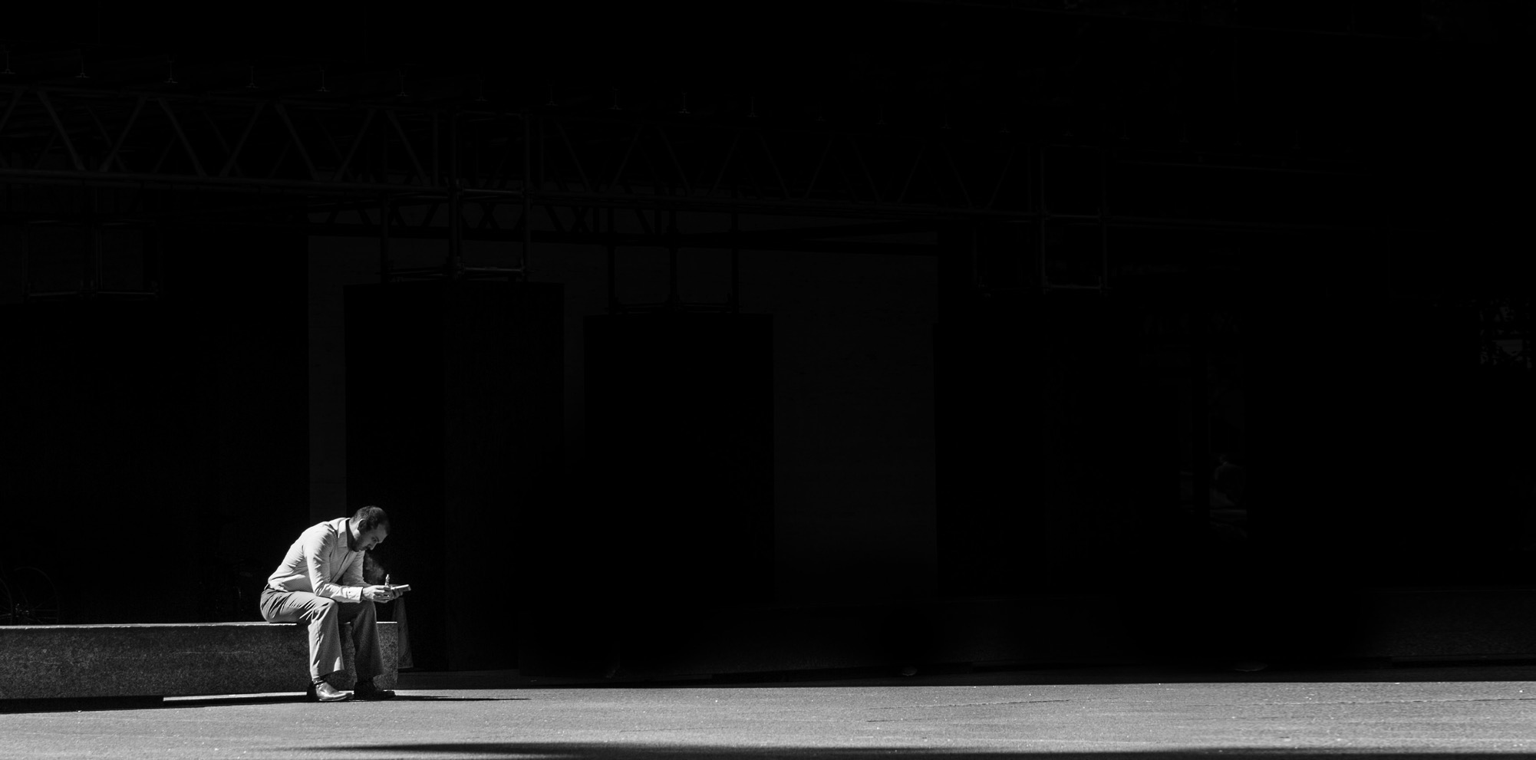
02
LITERATURE
REVIEW

Slide 8
02_ LITERATURE REVIEW
Publications list
[1]. Visual Anomaly Detection for Images: A Survey - Jie Yang et al: Different approaches of anomaly detection method classified.
[2] A survey on Image Data Augmentation for Deep Learning – Khoshgoftar and [3] Data Augmentation via Variational Auto-Encoders -Unay Garay-Maestre et al: Data Augmentation
[3] On normalization and algorithm selection for unsupervised outlier detection: Normalization and scaling.
Related Works and Research papers on Anomaly detection!

Slide 9

02_ LITERATURE REVIEW
Publications list
[4] Robust Anomaly Detection in Images using Adversarial Autoencoders -Lara Baggel et al: Autoencoders(KDE Approach)
[5] Variational Autoencoder based Anomaly Detection using Reconstruction Probability by Jinwon and Sungzoon, 2019 and [6] Auto-encoding variational bayes -P Kingma et al: Variational Autoencoder

Slide 10
02_ LITERATURE REVIEW
Publications list
[7] Generative adversarial networks -Ian J. Goodfellow et al and [8] Adversarial Feature Learning by Jeff Donahue et al: GAN
[9]. Unsupervised Anomaly Detection with Generative Adversarial Networks to Guide Marker Discovery AnoGan
[10] GANomaly: Semi-Supervised Anomaly
Detection via Adversarial Training:Ganomaly
[11]Hands-On Machine Learning with Scikit-Learn, Keras, and TensorFlow

Slide 11

03
Data Preparation

Slide 12
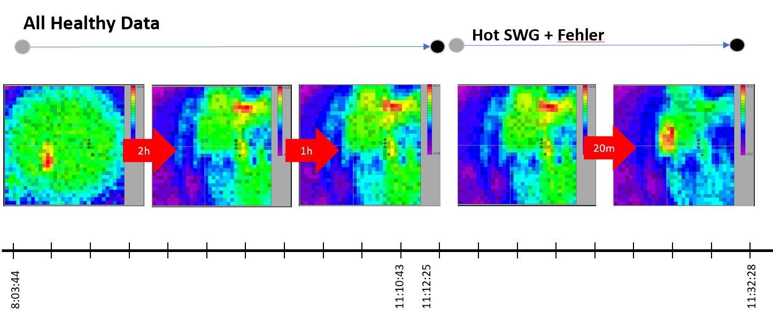
03 Data Preparation
We use 32x32 sized thermal Images of Switchgear equipment which are output of 4 different cameras.
After 3 hours of inspection, the equipment becomes defected and the changes in the healthy data emerge within 20 minutes of the experiment
Accordingly the datasets are labeled as healthy and faulty. Small amount of faulty labeled

Slide 13
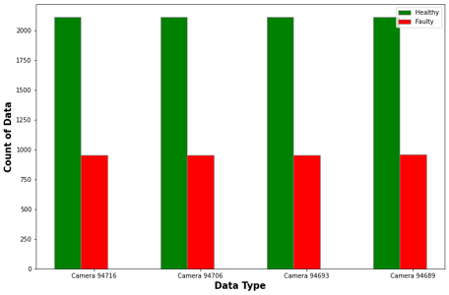
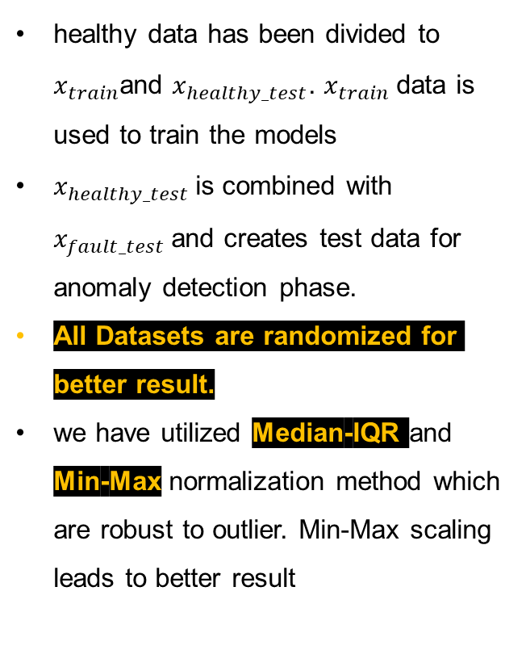
03 Data Preparation
healthy data has been divided to $x_{train}$and $x_{healthy_test}$. $x_{train}$data is used to train the models
$x_{healthy_test}$is combined with $x_{fault_test}$and creates test data for anomaly detection phase.
All Datasets are randomized for better result.
we have utilized Median-IQR and Min-Max normalization method which are robust to outlier. Min-Max scaling leads to better result

Slide 14
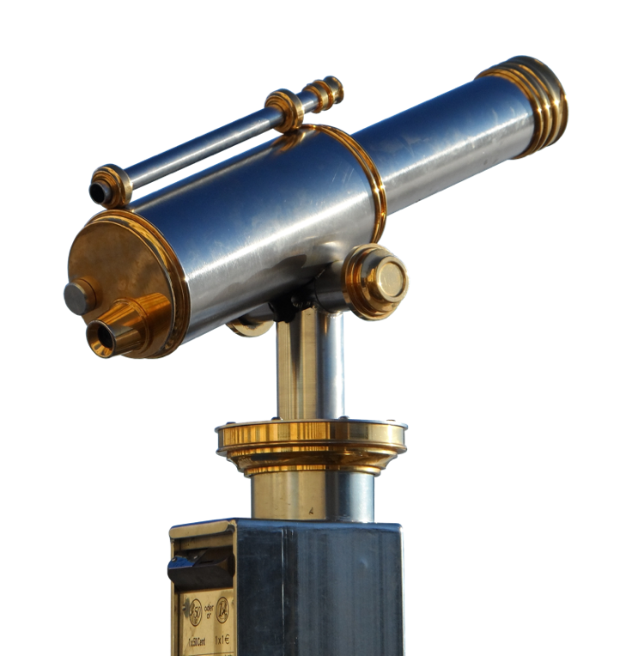
04
RESEARCH

Slide 15
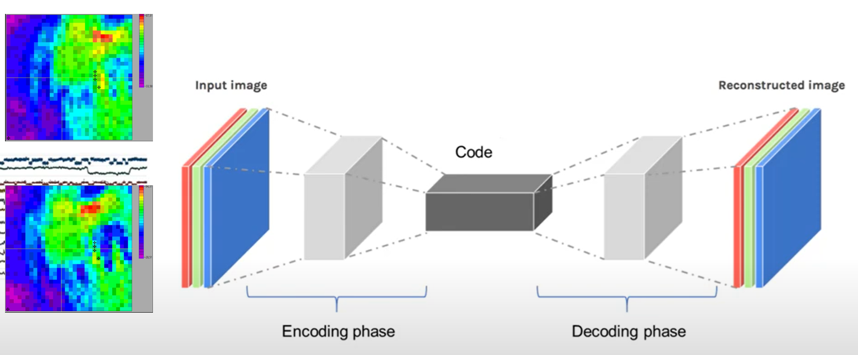
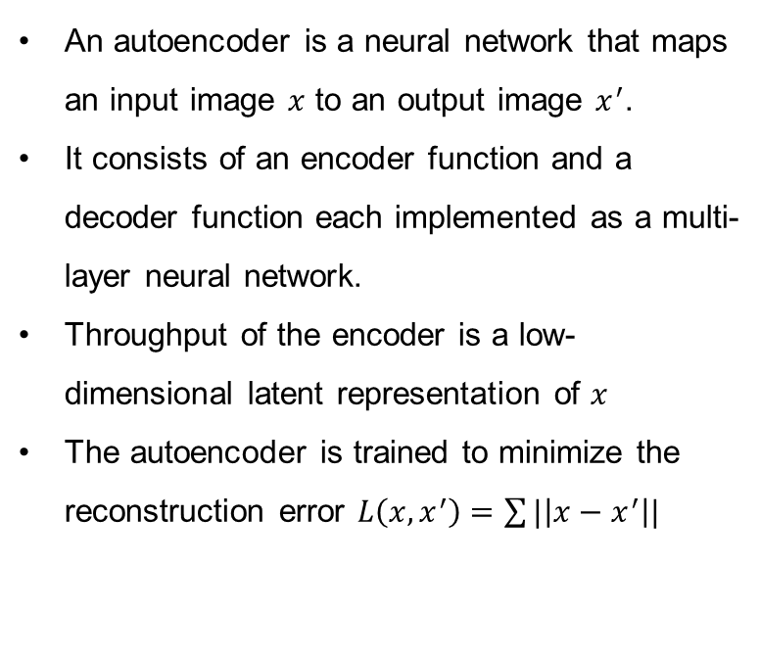
04 RESEARCH AND RESULTS
4.1. Anomaly detection using Autoencoders
An autoencoder is a neural network that maps an input image $x$ to an output image $x^{′}$.
It consists of an encoder function and a decoder function each implemented as a multi-layer neural network.
Throughput of the encoder is a low-dimensional latent representation of $x$
The autoencoder is trained to minimize the reconstruction error $L\left(x,x^{′}\right)=\sum{|\left|x−x^{′}\right||}$
healthy images used for training, so AE assumes that all images gave the same distribution in latent space and the same
reconstruction loss.
In anomaly detection AE produces different latent distributions and higher reconstruction error.
In our experiments, as anomaly score A(x), we have utilized reconstruction error and kde(kernel density estimation)

Slide 16
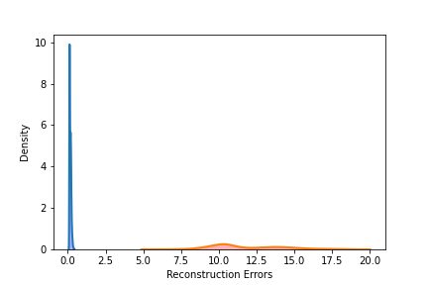
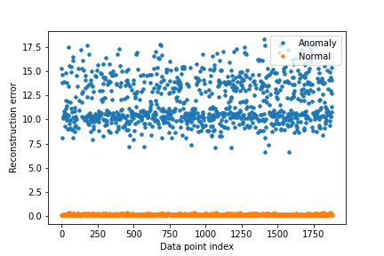
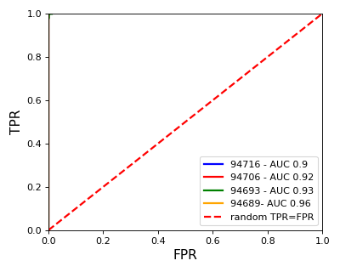
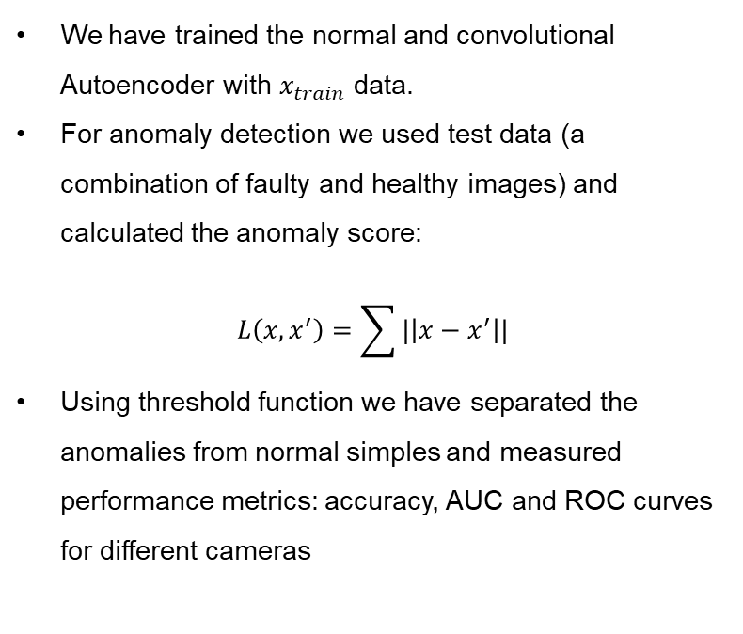
04 RESEARCH AND RESULTS
Reconstruction error as Anomaly score A(x)
We have trained the normal and convolutional Autoencoder with $x_{train}$data.
For anomaly detection we used test data (a combination of faulty and healthy images) and calculated the anomaly score:
$$L\left(x,x^{′}\right)=\sum{|\left|x−x^{′}\right||}$$
Using threshold function we have separated the anomalies from normal simples and measured performance metrics: accuracy, AUC and ROC curves for different cameras

Slide 17
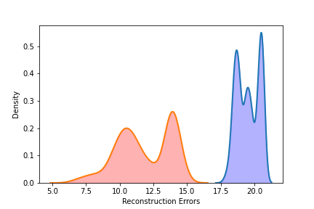
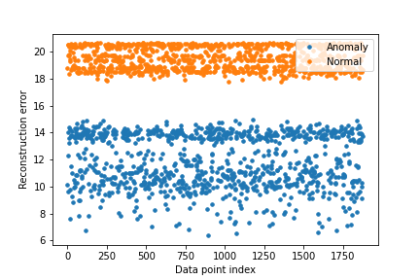
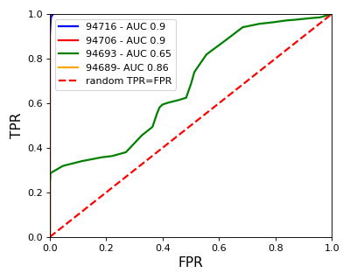
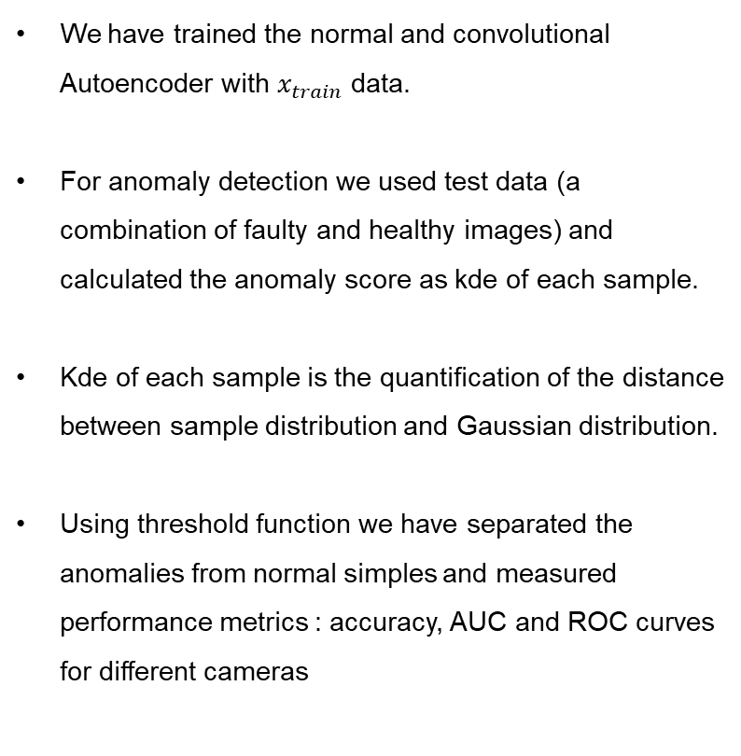
04 RESEARCH AND RESULTS
Kernel Density Estimationas Anomaly score A(x)
We have trained the normal and convolutional Autoencoder with $x_{train}$data.
For anomaly detection we used test data (a combination of faulty and healthy images) and calculated the anomaly score as kde of each sample.
Kde of each sample is the quantification of the distance between sample distribution and Gaussian distribution.
Using threshold function we have separated the anomalies from normal simples and measured performance metrics : accuracy, AUC and ROC curves for different cameras

Slide 18
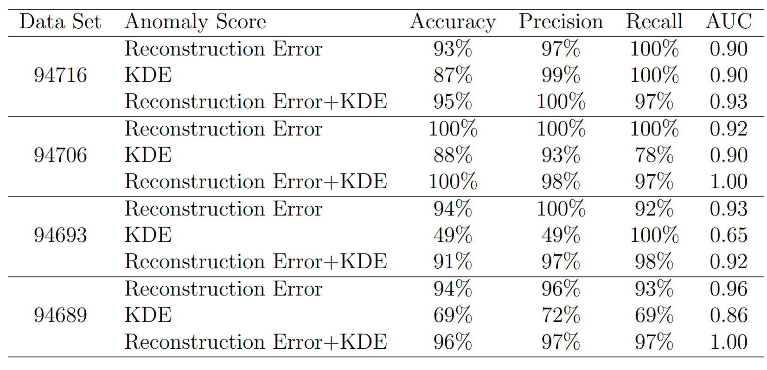
04 RESEARCH AND RESULTS
Results for Autoencoder

Slide 19
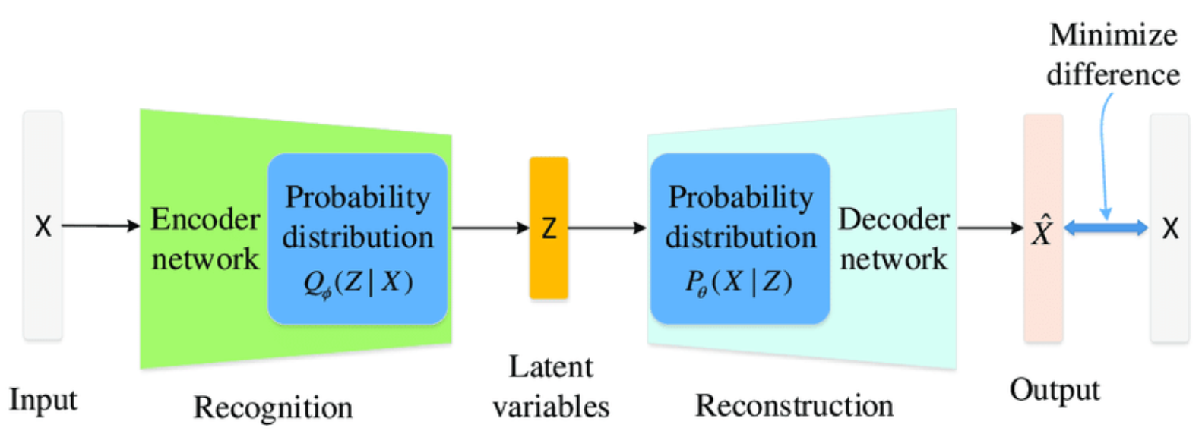
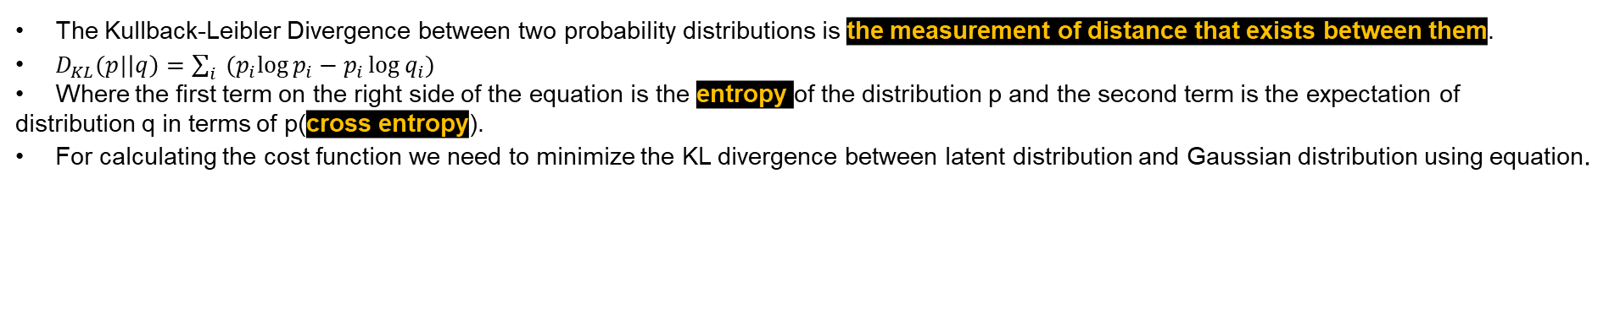
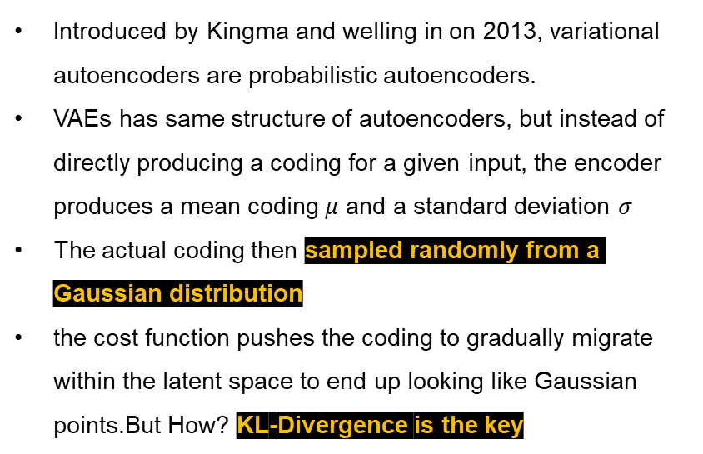
04 RESEARCH AND RESULTS
4.2. Anomaly detection using Variational Autoencoders
Introduced by Kingma and welling in on 2013, variational autoencoders are probabilistic autoencoders.
VAEs has same structure of autoencoders, but instead of directly producing a coding for a given input, the encoder produces a mean coding $μ$ and a standard deviation $σ$
The actual coding then sampled randomly from a Gaussian distribution
the cost function pushes the coding to gradually migrate within the latent space to end up looking like Gaussian points.But How? KL-Divergence is the key
The Kullback-Leibler Divergence between two probability distributions is the measurement of distance that exists between them.
$D_{KL}(p|\left|q\right)=\sum_{i}{{(p}_{i}\log{p_{i}−p_{i}\log{q_{i})}}}$
Where the first term on the right side of the equation is the entropy of the distribution p and the second term is the expectation of
distribution q in terms of p(cross entropy).
For calculating the cost function we need to minimize the KL divergence between latent distribution and Gaussian distribution using equation.

Slide 20
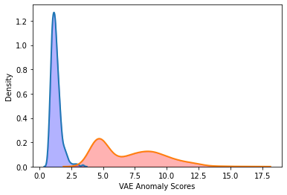
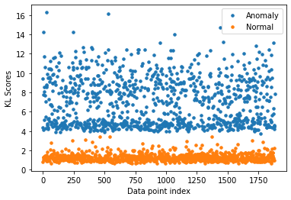
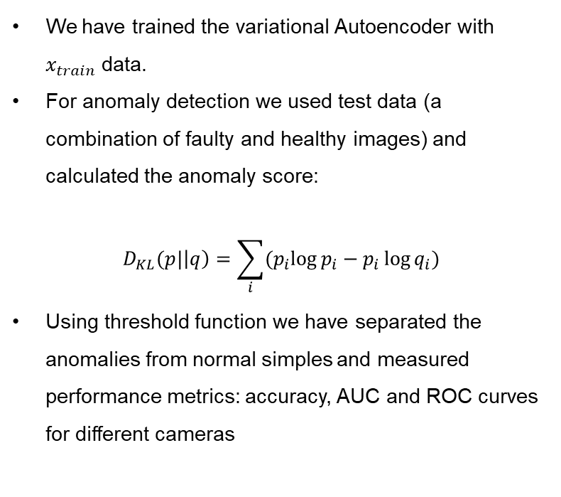
04 RESEARCH AND RESULTS
KL Divergence as Anomaly score A(x)
We have trained the variational Autoencoder with $x_{train}$data.
For anomaly detection we used test data (a combination of faulty and healthy images) and calculated the anomaly score:
$$D_{KL}(p|\left|q\right)=\sum_{i}{{(p}_{i}\log{p_{i}−p_{i}\log{q_{i})}}}$$
Using threshold function we have separated the anomalies from normal simples and measured performance metrics: accuracy, AUC and ROC curves for different cameras

Slide 21
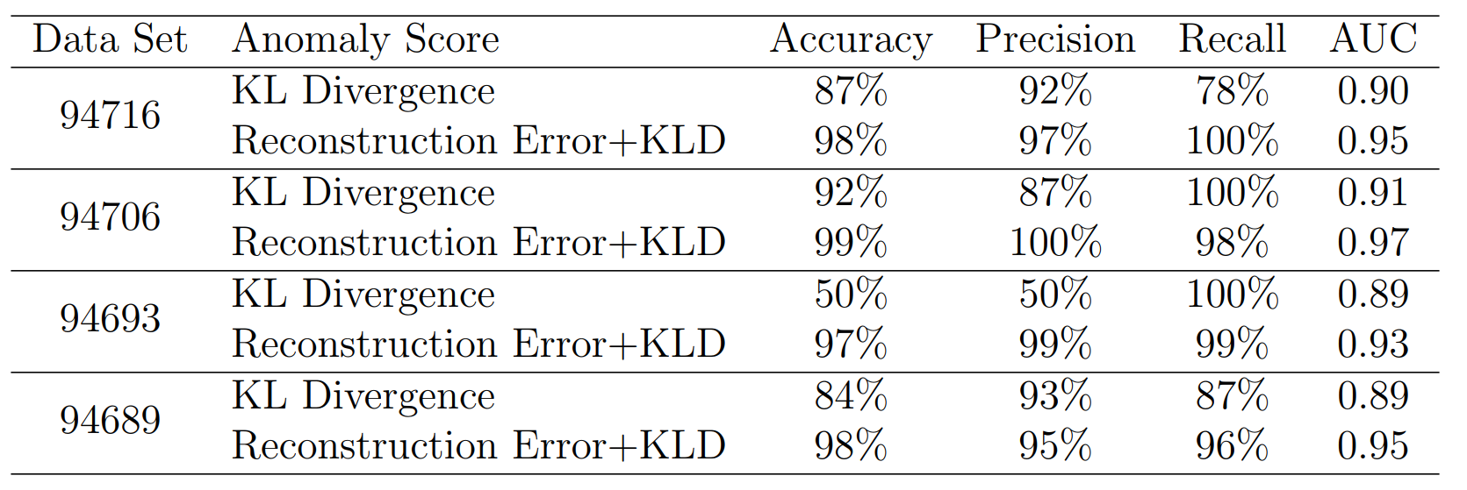
04 RESEARCH AND RESULTS
Results for Variational Autoencoder

Slide 22

04 RESEARCH AND RESULTS
4.3. Anomaly detection using GANs
GAN models are comprised of a generator network and a discriminator that competes with each other.
The generator takes a random distribution as input and outputs some data. The generator offers the same functionality as a decoder in a variational autoencoder
Discriminator takes the fake image from the generator or real image from the training set as input and must guess whether the input is fake of real.
During the training, the generator and the discriminator have opposite goals and compete with each other. The generator is trained to produce images that look real enough to trick the discriminator.
To identify anomalies with GAN we train a generative model, and a discriminator to distinguish between generated and real
normal data during training. In this way we can have better feature extraction of normal data in latent space.
What is training procedure? What Cost function for Optimization to be used?

Slide 23
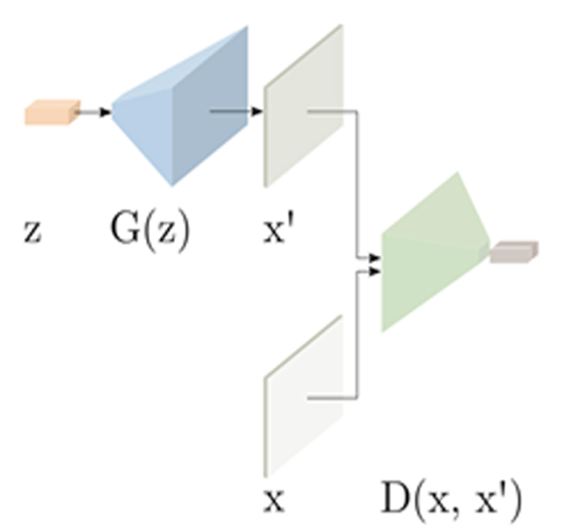
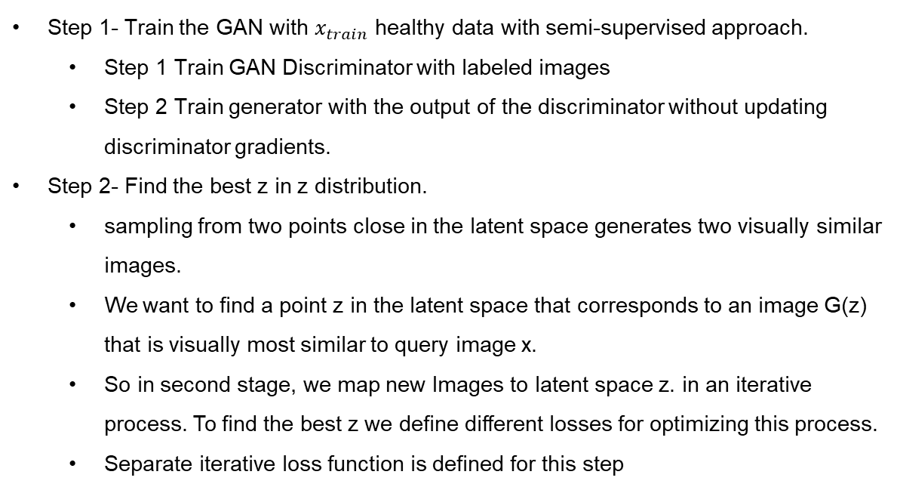
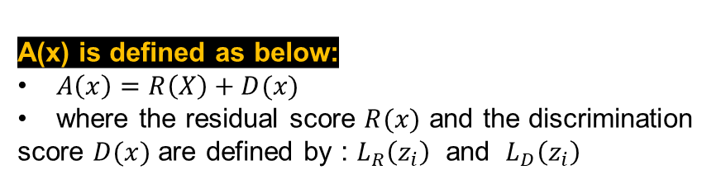
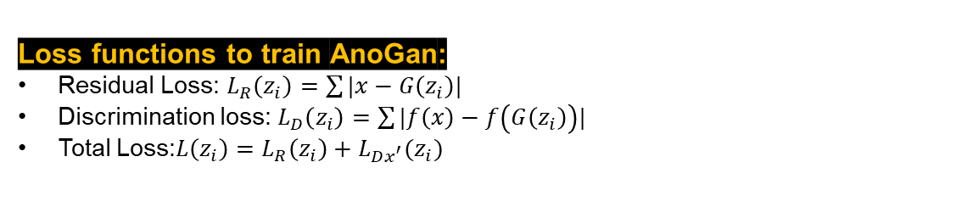
04 RESEARCH AND RESULTS
4.1.1 Anomaly Detection with Anogan
Step 1- Train the GAN with $x_{train}$ healthy data with semi-supervised approach.
Step 1 Train GAN Discriminator with labeled images
Step 2 Train generator with the output of the discriminator without updating discriminator gradients.
Step 2- Find the best z in z distribution.
sampling from two points close in the latent space generates two visually similar images.
We want to find a point z in the latent space that corresponds to an image G(z) that is visually most similar to query image x.
So in second stage, we map new Images to latent space z. in an iterative process. To find the best z we define different losses for optimizing this process.
Separate iterative loss function is defined for this step
Loss functions to train AnoGan:
Residual Loss: $L_{R}\left(z_{i}\right)=\sum{|x−G\left(z_{i}\right)|}$
Discrimination loss: $L_{D}\left(z_{i}\right)=\sum{|f\left(x\right)−f\left(G\left(z_{i}\right)\right)|}$
Total Loss:$L\left(z_{i}\right)=L_{R}\left(z_{i}\right)+L_{Dx^{′}}(z_{i})$
A(x) is defined as below:
$A\left(x\right)=R\left(X\right)+D(x)$
where the residual score $R(x)$ and the discrimination
score $D(x)$ are defined by : $L_{R}\left(z_{i}\right)$ and $L_{D}\left(z_{i}\right)$

Slide 24
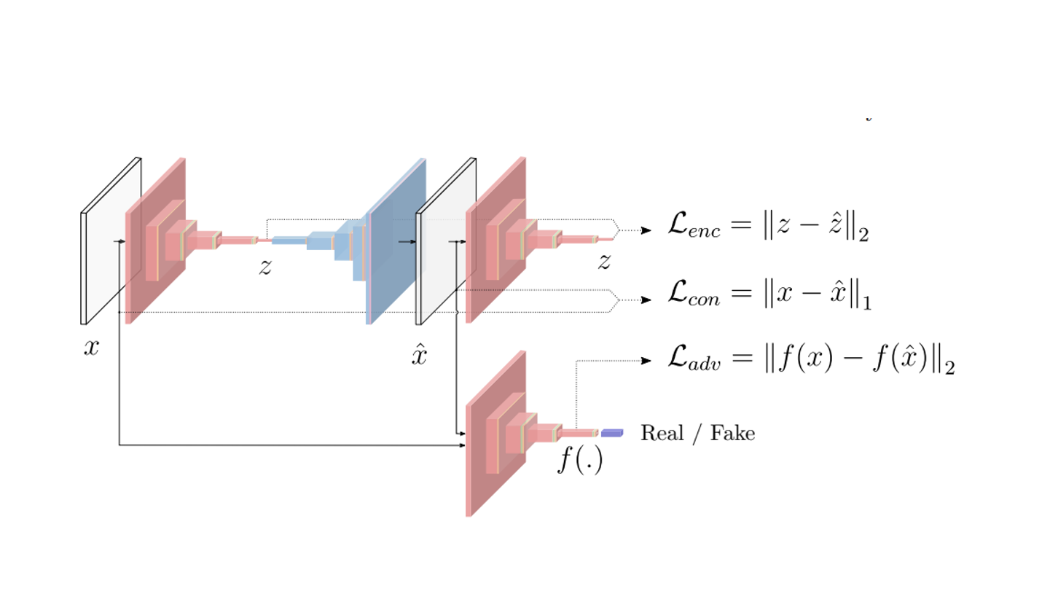
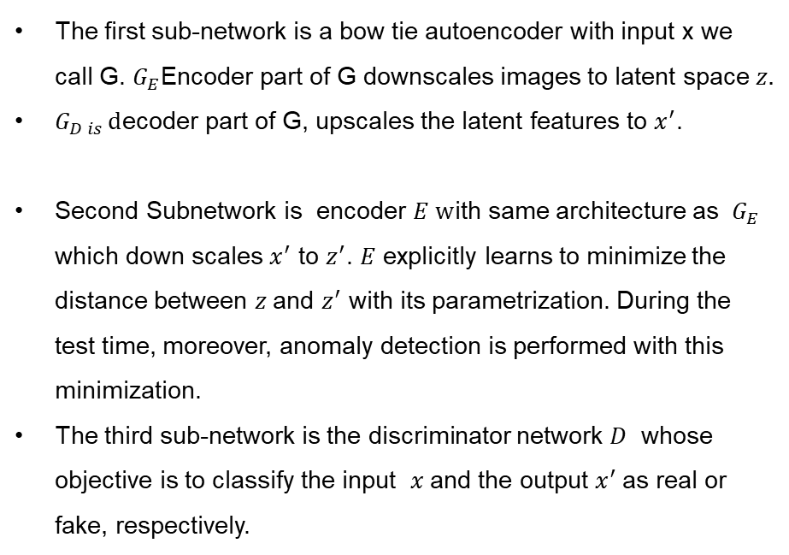
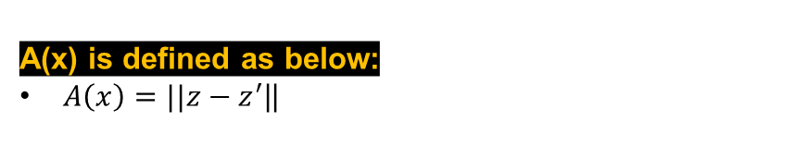
04 RESEARCH AND RESULTS
4.1.2 Anomaly detection using Ganomaly Approach
The first sub-network is a bow tie autoencoder with input x we call G. $G_{E}$Encoder part of G downscales images to latent space $z.$
$G_{D is }d$ecoder part of G, upscales the latent features to $x^{′}$.
Second Subnetwork is encoder $E w$ith same architecture as $G_{E}$ which down scales $x^{′}$ to $z^{′}$. $E$ explicitly learns to minimize the distance between $z$and $z^{′}$ with its parametrization. During the test time, moreover, anomaly detection is performed with this minimization.
The third sub-network is the discriminator network $D$ whose objective is to classify the input $x$and the output $x^{′}$as real or fake, respectively.
A(x) is defined as below:
$A\left(x\right)=||z−z^{′}$||

Slide 25
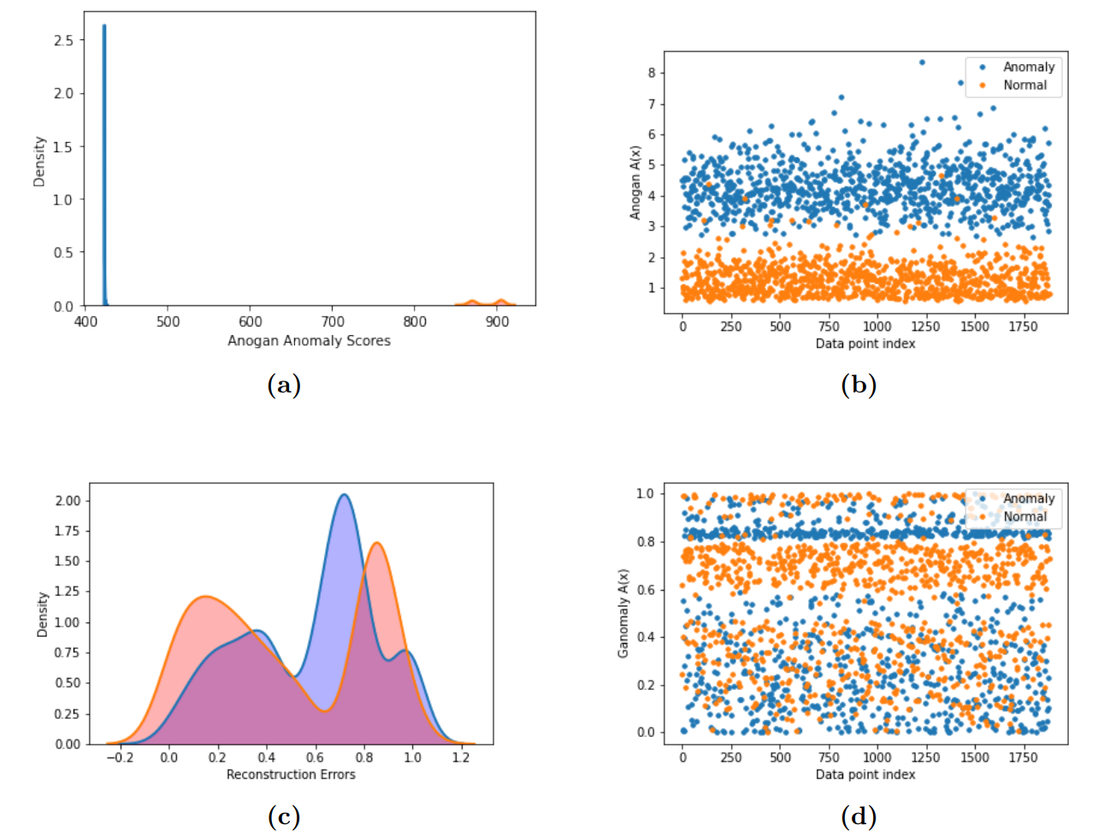
04 RESEARCH AND RESULTS
Results for GAN Based Approaches

Slide 26
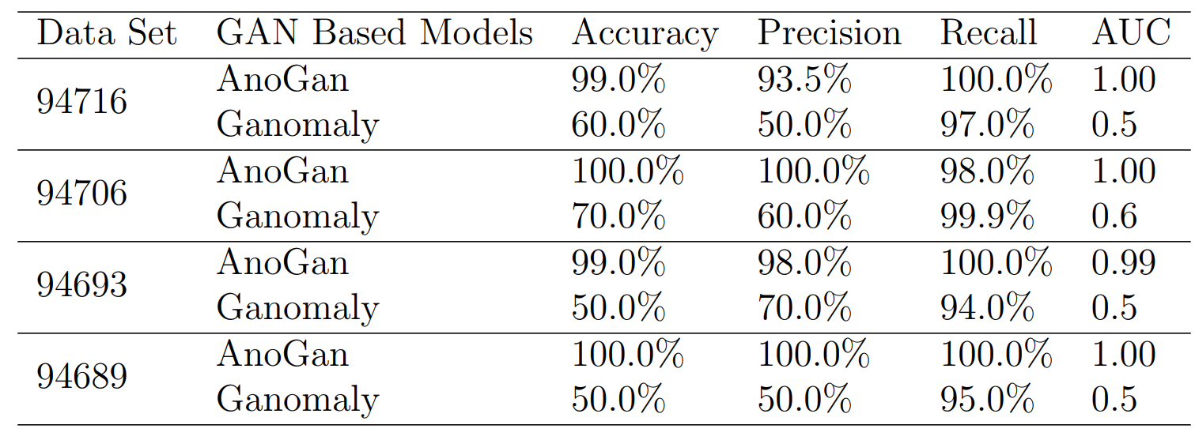
04 RESEARCH AND RESULTS
Results for GAN Based Approaches

Slide 27

05
CONCLUSION

Slide 28
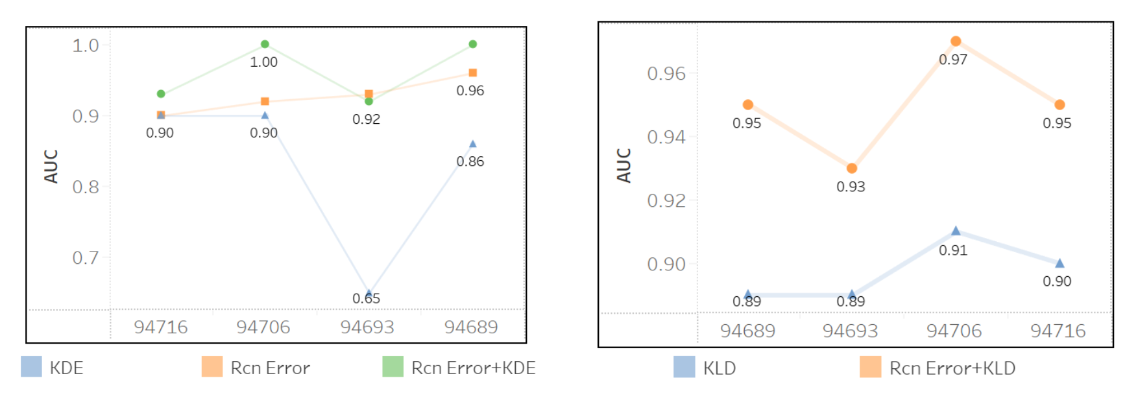
05_ Conclusions
Combination of anomaly scores improves results
Combining two anomaly scores leads to improved accuracy:
Combination of recon errors and kde in autoencoder
Recon errors and KL divergence in variational autoencoder

Slide 29
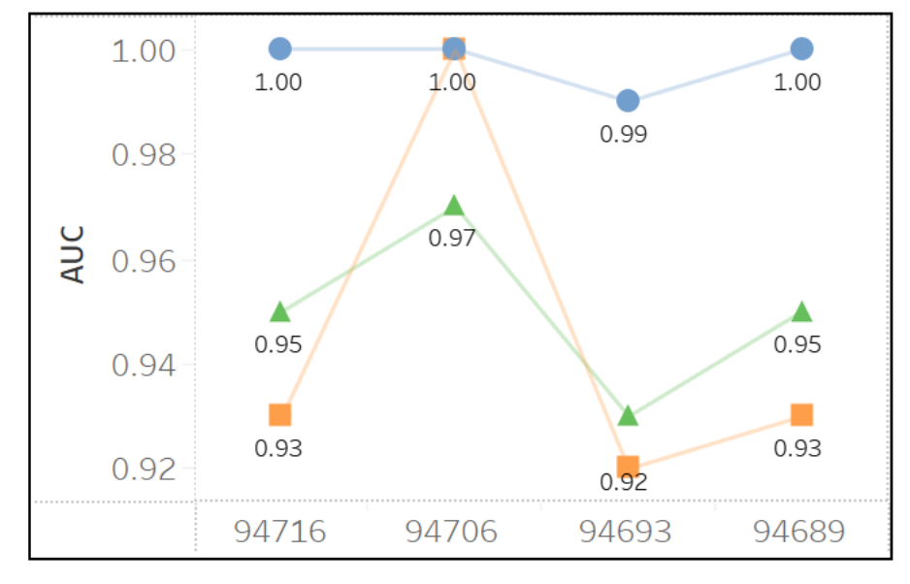
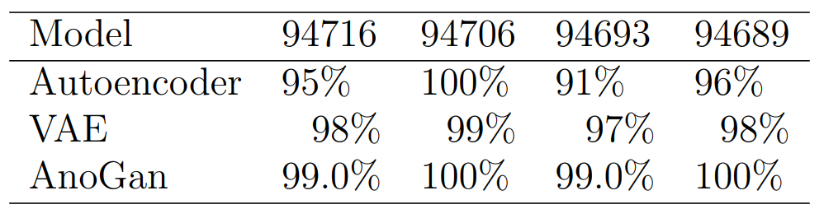
05_ Conclusions
AnoGan Performs better
than Autoencoder
approaches
we came to the conclusion that anomaly detection with AnoGan results to higher performance measures compared to Variational and classic autoencoders. The below table summarizes the classification measures of three approaches(Excluding the poor performance of Ganomaly).

Slide 30
05_ Conclusions
Role of Better Feature extraction
Better feature extraction in normal data is the key to anomaly detection approaches.
All approaches are designing the pipeline and defining loss function to get the best feature extraction from normal data in the training phase.
This must be the main focus area in order to find state-of-the-art approaches

Slide 31
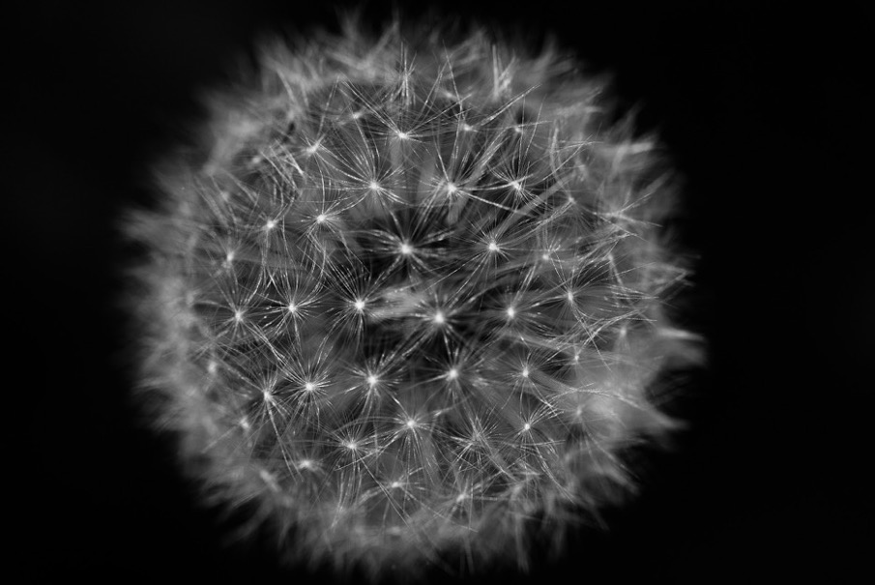
06
Codes and Report
Codes are available in:
https://github.com/Big-Data-And-Data-Analytics/case-study-1-october-2021-gamechangers/tree/main/Auto%20Encoder
The report is prepared in overleaf:
https://www.overleaf.com/project/624b69121293140e488768fc

Slide 32

07
Project Planning

Slide 33





07- Project Planning
Project planning in Trello
Weekly Meetings
Task Assignment in Trello
Brain Storming
Knowledge Sharing

Slide 34

07
Document the benchmark results in order to make an archival of the research paper.
Change model structures and define new training losses to find state-of-the-art approaches with better results in anomaly detection for publication.
What is next?

Slide 35

END

